Slide 1
19Z601- MACHINE LEARNING
UNIT- 2 LINEAR MODELS
Presented by
Ms.Anisha.C.D
Assistant Professor
CSE

Slide 2
Types of Learning
Types of Machine Learning
Supervised Learning
Unsupervised Learning
Semi-Supervised Learning
Reinforcement Learning
Classification
Regression
Cluster Analysis
Association Mining
Dimensionality Reduction

Slide 3
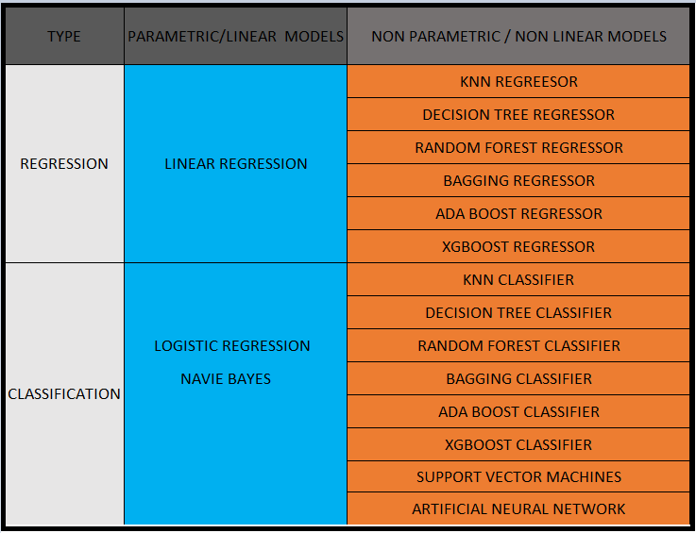
Supervised Learning

Slide 4
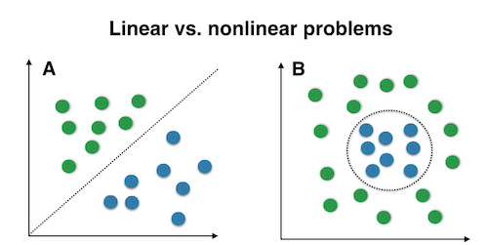
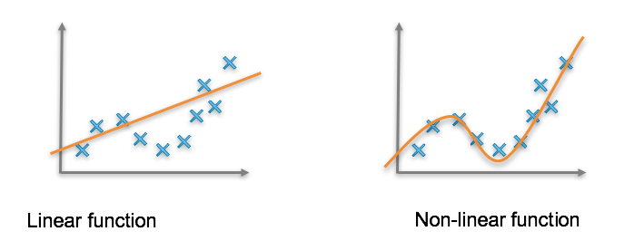
What is Parametric/Linear Model?
For a linear equation, the highest order of any term is 1. (unit power)

Slide 5
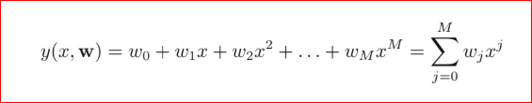
What is Linear Model? - Example
The polynomial coefficients w₀,...,w_{M} are collectively denoted by the vector w.
Note that, although the polynomial function y(x, w) is a nonlinear function of x, it is a linear function of the coefficients w.
Functions, such as the polynomial, which are linear in the unknown parameters have important properties and are called linear models.

Slide 6
Linear Models - Regression
Regression analysis is a statistical framework for quantifying the relationship between a dependent variable and one or more independent variables.
Regression analysis comes in many forms—linear, logistic, ridge, polynomial, and more—many more!
Each has an application for datasets with specific characteristics.
Generally, these models can be categorized as linear regression, multiple linear regression, and nonlinear regression.

Slide 7
Linear Models For Regression – Simple Linear Regression Model
Linear regression is a powerful statistical tool used to quantify the relationship between variables in ways that can be used to predict future outcomes.
This method of analysis is used in stock forecasting, portfolio management, scientific analysis, and many more applications.
Whenever one has at least two variables in their data—linear regression might be useful.

Slide 8
Goal of Linear Regression Model
The goal of linear regression is to predict the value of the dependent variable based on the observed value of an independent variable.
In the case of simple linear regression, this goal is achieved via modeling the relationship between a dependent variable and a single independent variable.
In the case of multiple linear regression, the relationship between the dependent variable is considered with respect to two or more independent variables.

Slide 9
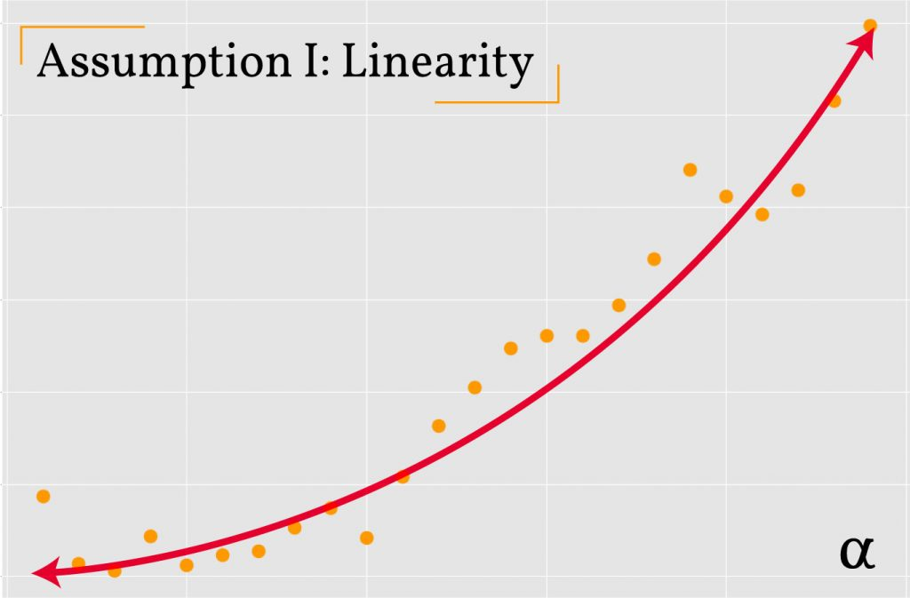
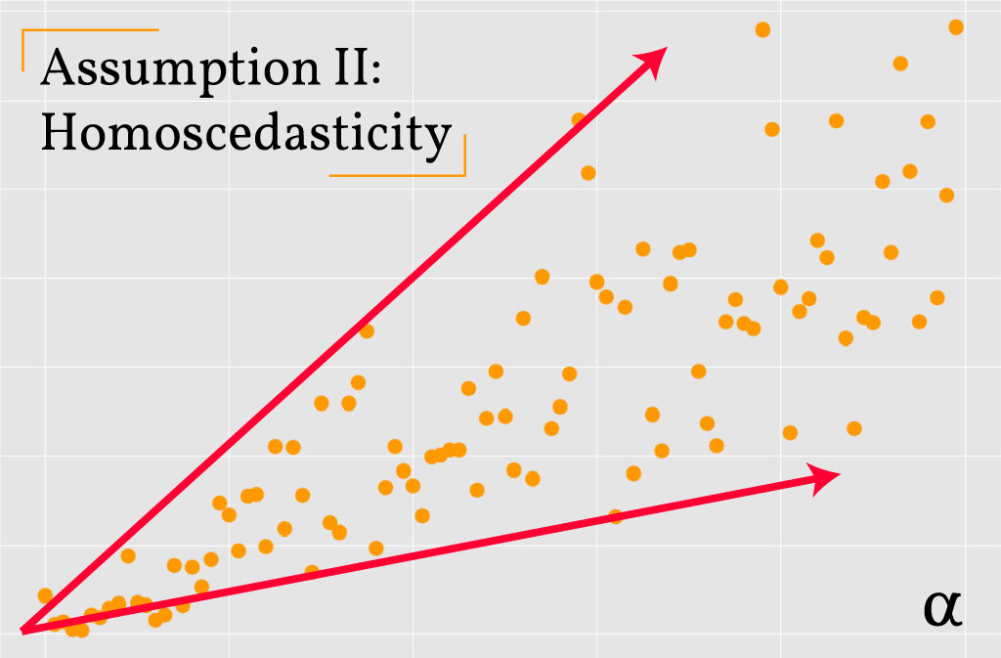
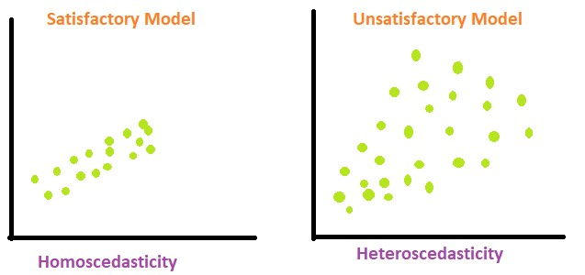
Assumptions of Linear Regression
Illustration of Heteroscedasticity
Illustration of Non-Linearity

Slide 10
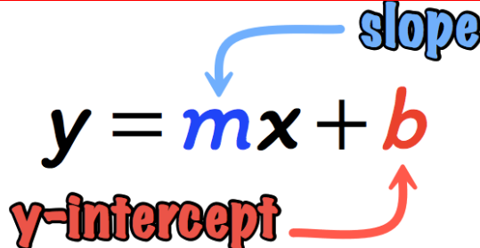
Formulae of Simple Linear Regression Model
Linear regression fits a line of best fit such that the distance of predicted values from the mean of observed values is minimized.
The formulae for varying Linear regression models are based on the algebraic slope-intercept form.

Slide 11
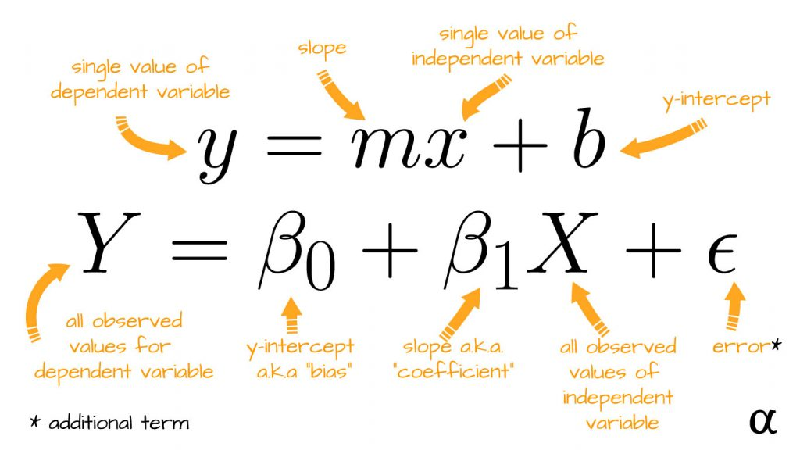
Img source : https://www.alpharithms.com/simple-linear-regression-modeling-502111/

Slide 12
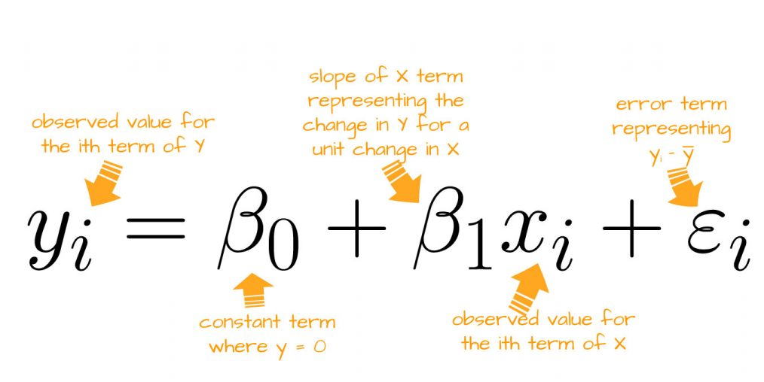

Slide 13
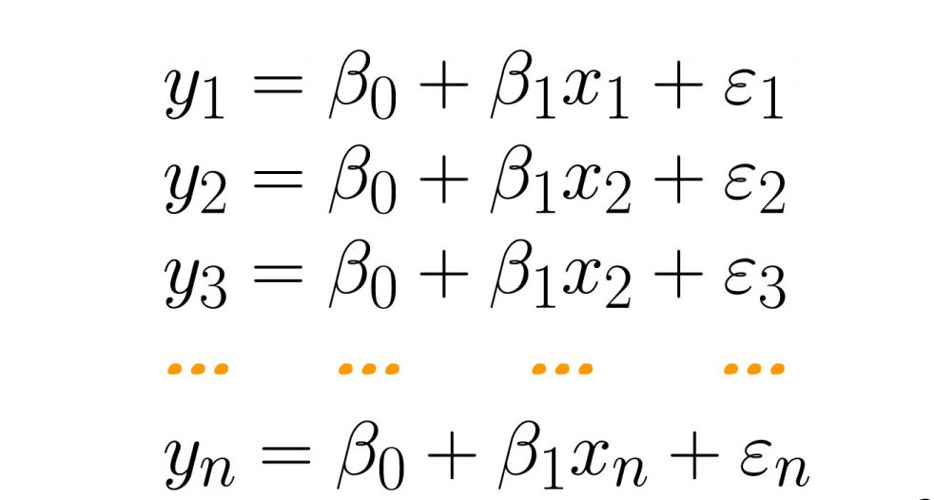

Slide 14
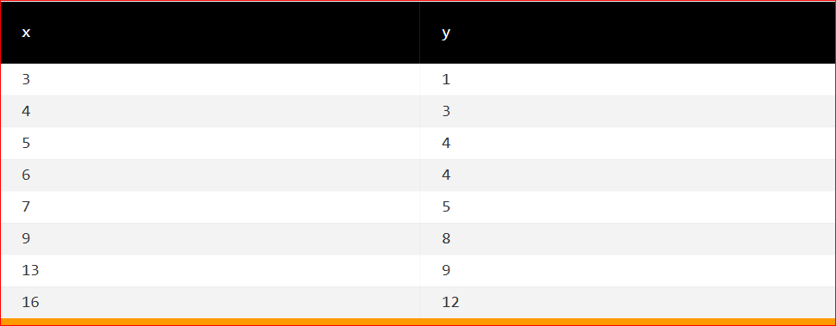
Simple Linear Regression – Sample Data
Img source : https://www.alpharithms.com/simple-linear-regression-modeling-502111/

Slide 15
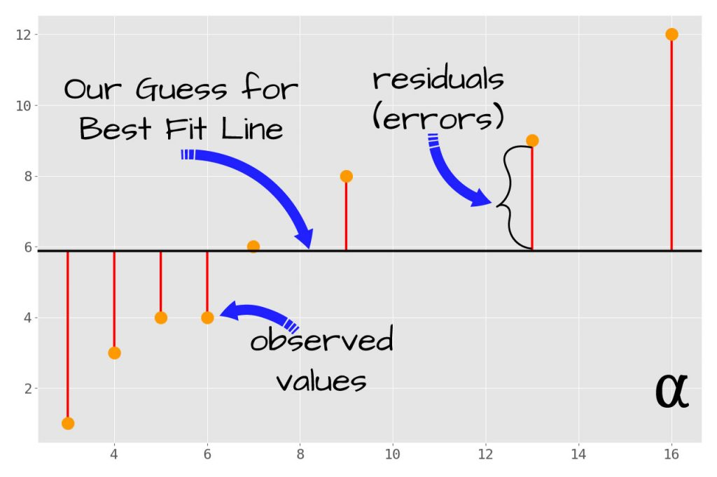
Create a scatterplot of the observed values and also an initial “best guess” line—being “fit” using the mean of the dependent variable (y)
values y = mean(Y).
Line of Best Fit: the black horizontal line which is currently just our “best guess” which is simply y = mean(y-values).
Observed Values: the yellow dots representing the (x, y) pairs of our data where the X is our independent (predictor) variable and the y is our dependent (response) variable.
Residuals: the red lines illustrating the between our current y-values and our line of best fit.
Coefficient of Determination (r2): A sum of the standardized residual values that provides a non-zero estimate of the total error in our model. Simply the sum of the squared values of all the red lines.
Img source : https://www.alpharithms.com/simple-linear-regression-modeling-502111/

Slide 16
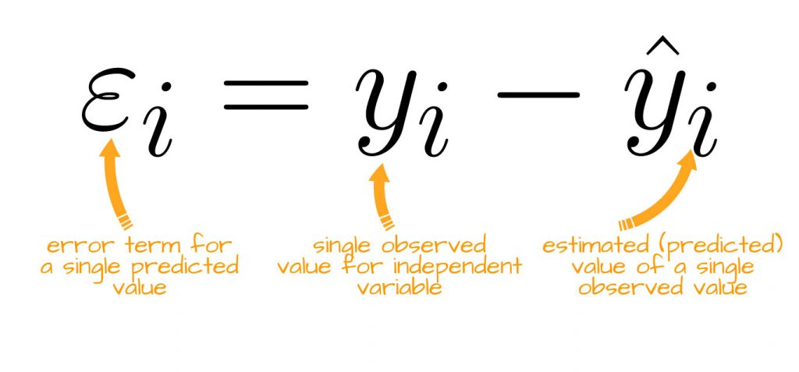
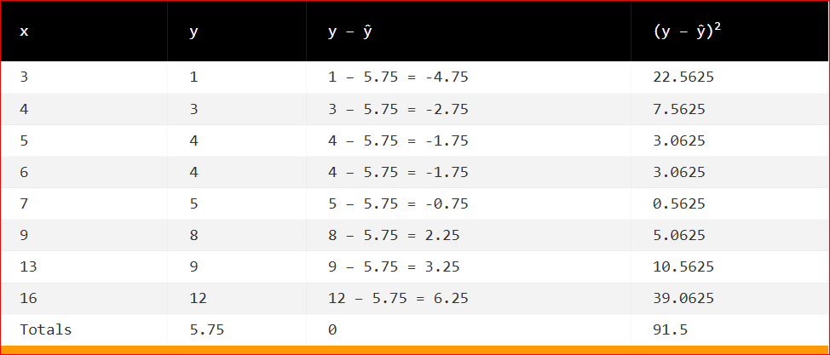
Calculating the Error
The goal of regression is to find the equation of the line that will minimize the sum of the squared values of our residuals (Coefficient of Determination.)
Img source : https://www.alpharithms.com/simple-linear-regression-modeling-502111/

Slide 17
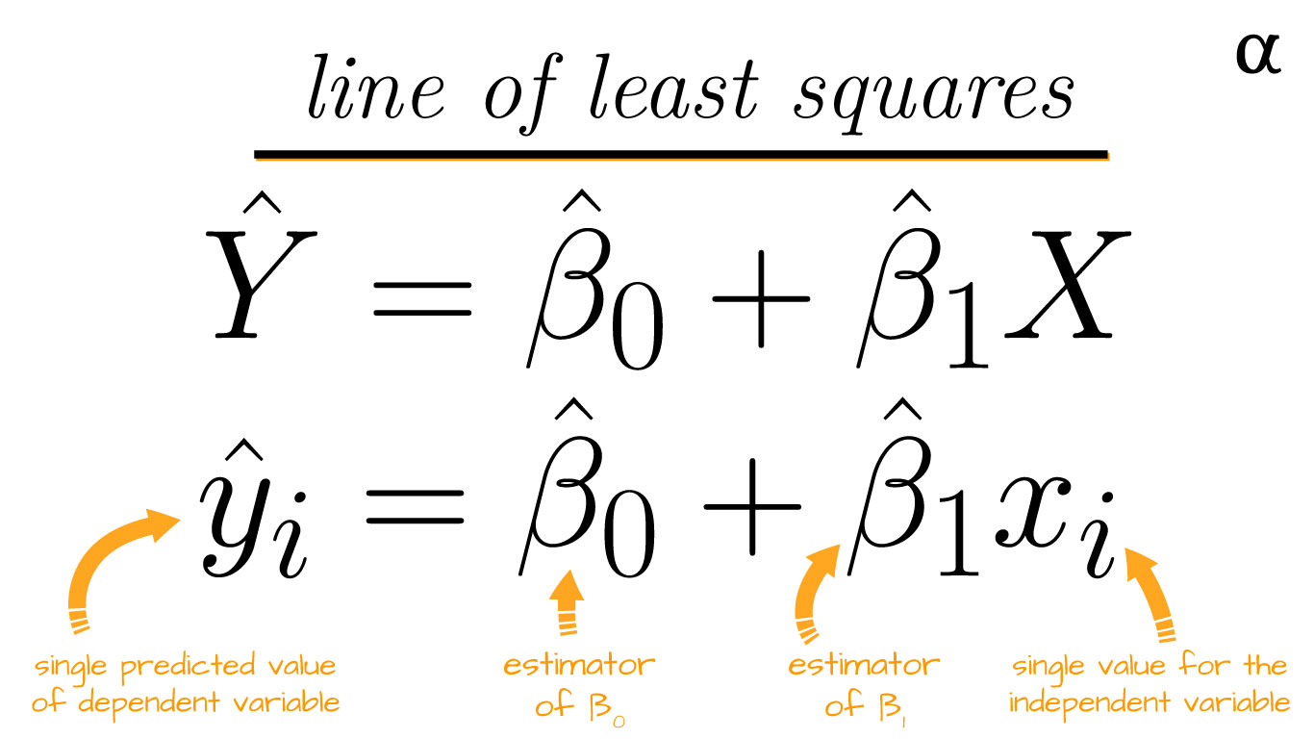
Simple Linear Regression Model Building
Img source : https://www.alpharithms.com/simple-linear-regression-modeling-502111/

Slide 18
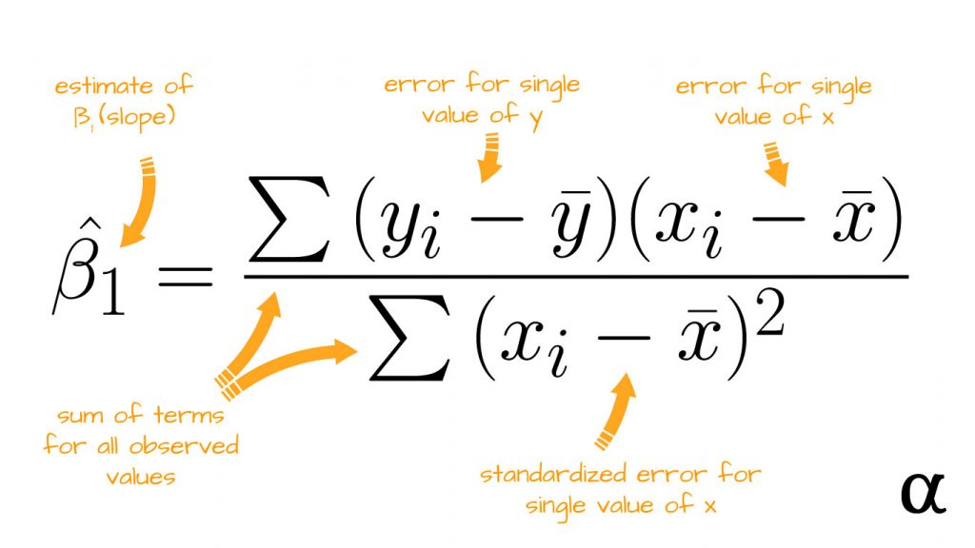
Estimation of Parameters
Img source : https://www.alpharithms.com/simple-linear-regression-modeling-502111/

Slide 19
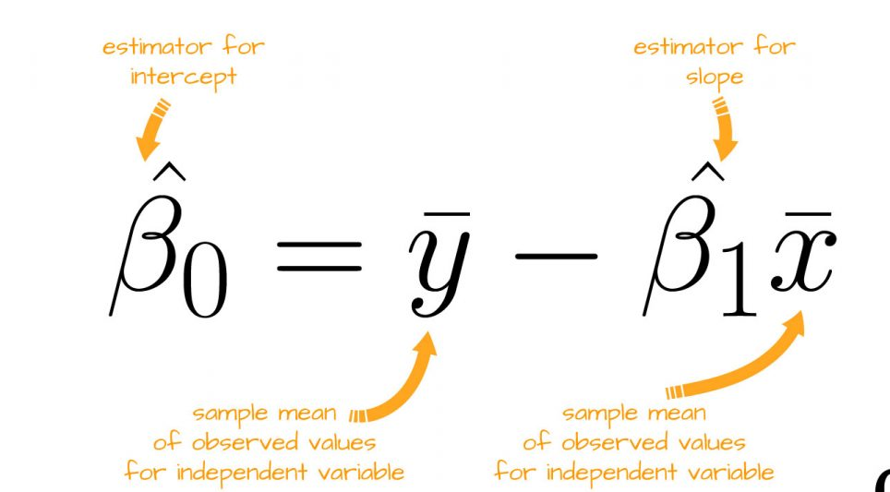
Img source : https://www.alpharithms.com/simple-linear-regression-modeling-502111/

Slide 20
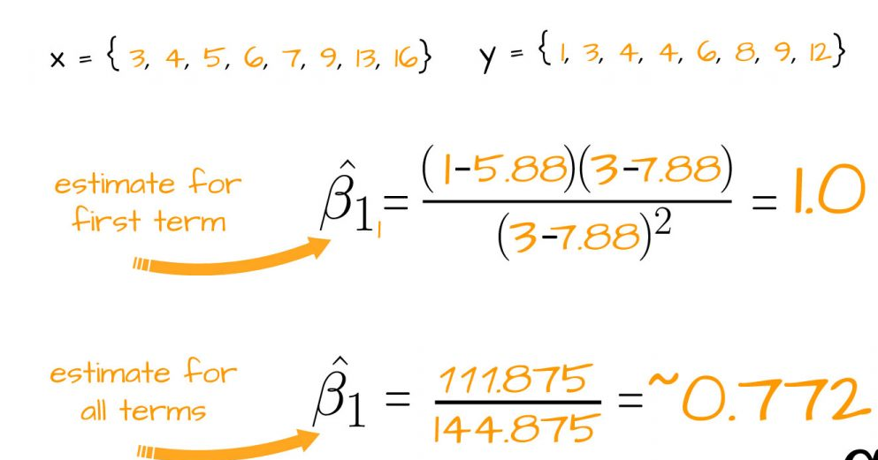
Img source : https://www.alpharithms.com/simple-linear-regression-modeling-502111/

Slide 21
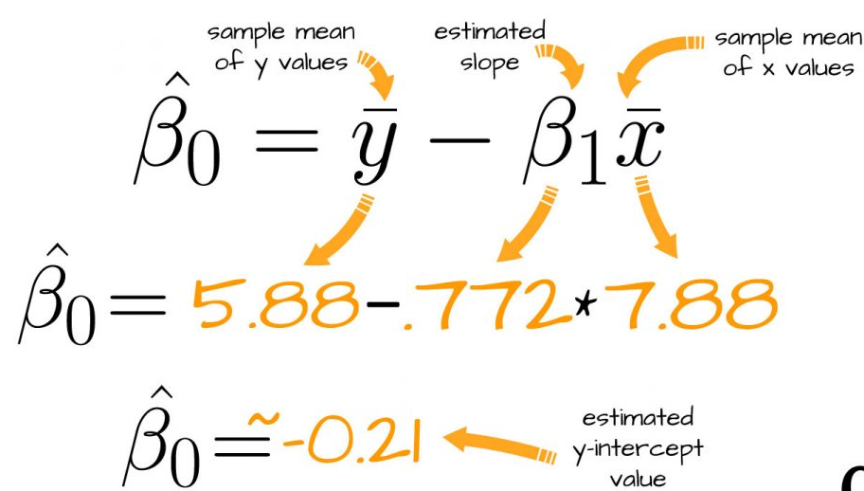
Img source : https://www.alpharithms.com/simple-linear-regression-modeling-502111/

Slide 22
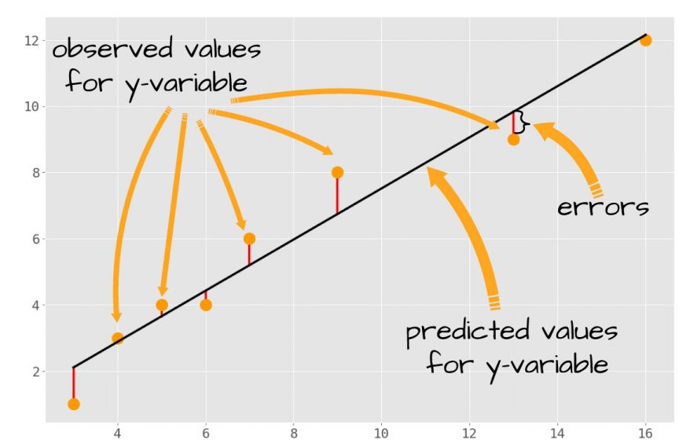
This line represents the least-squares regression line such that the sum of the square errors between our observed values and predicted values is minimized.
The equation for this line is
y = -.21 + .772 * x and can be used to predict future values of x.
Img source : https://www.alpharithms.com/simple-linear-regression-modeling-502111/

Slide 23
Try this (Homework)
You are given a dataset containing information about the number of hours students spend studying and their corresponding scores on a test. Your task is to perform simple linear regression to predict test scores based on the number of hours studied using the following dataset.
No.of Hours Studies | Test Scores
2 | 75
3 | 82
4 | 93
5 | 89
6 | 98

